Slide 1
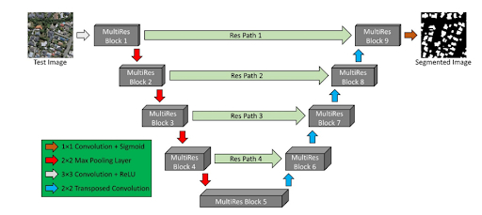
MODULE I: BUILDING DETECTION
Annotate Rooftop Types
PRE-PROCESSING
MODULE II: ROOFTOP CLASSIFICATION & BOUNDARY DETECTION
Clipping of images
Resizing & Normalization
Shallow CNN
ResNet50
EfficientNetB4
MULTIRES UNET
Majority voting
AIRS DATASET
EXTRACTED ROOFTOPS
BOUNDARY DETECTION
White balancing
Fuzzy Histogram Hyperbolization
Gaussian blur
Canny Edge Detection
ROOF TYPE WITH EDGE DETECTED ROOFTOP
BACKGROUND SUBTRACTION
Thresholding
MODULE III: MAXIMAL MODULE FITTING
Bounding Boxes
Superimpose module grid on roof
Background subtraction
Color filling
Flat
Perform module fitting in landscape
CLASSIFIED ROOF TYPE WITH GUESSTIMATED NO OF PANELS
Tilted
Perform module fitting in landscape & portrait

